Slide 1
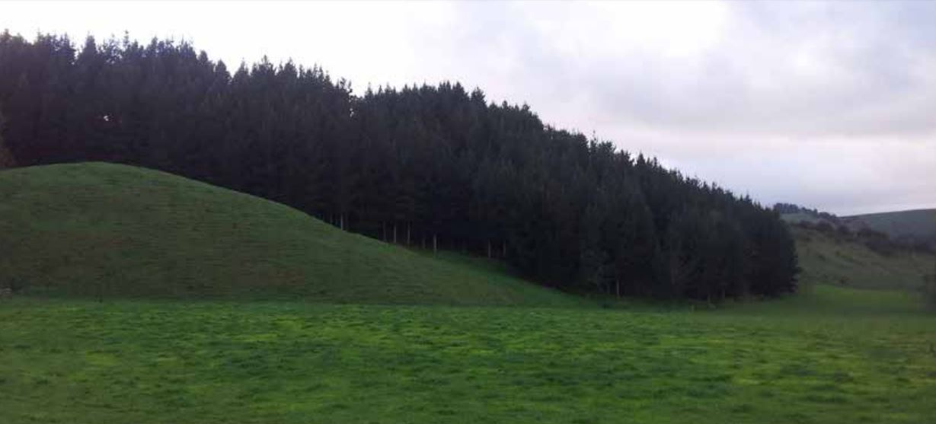
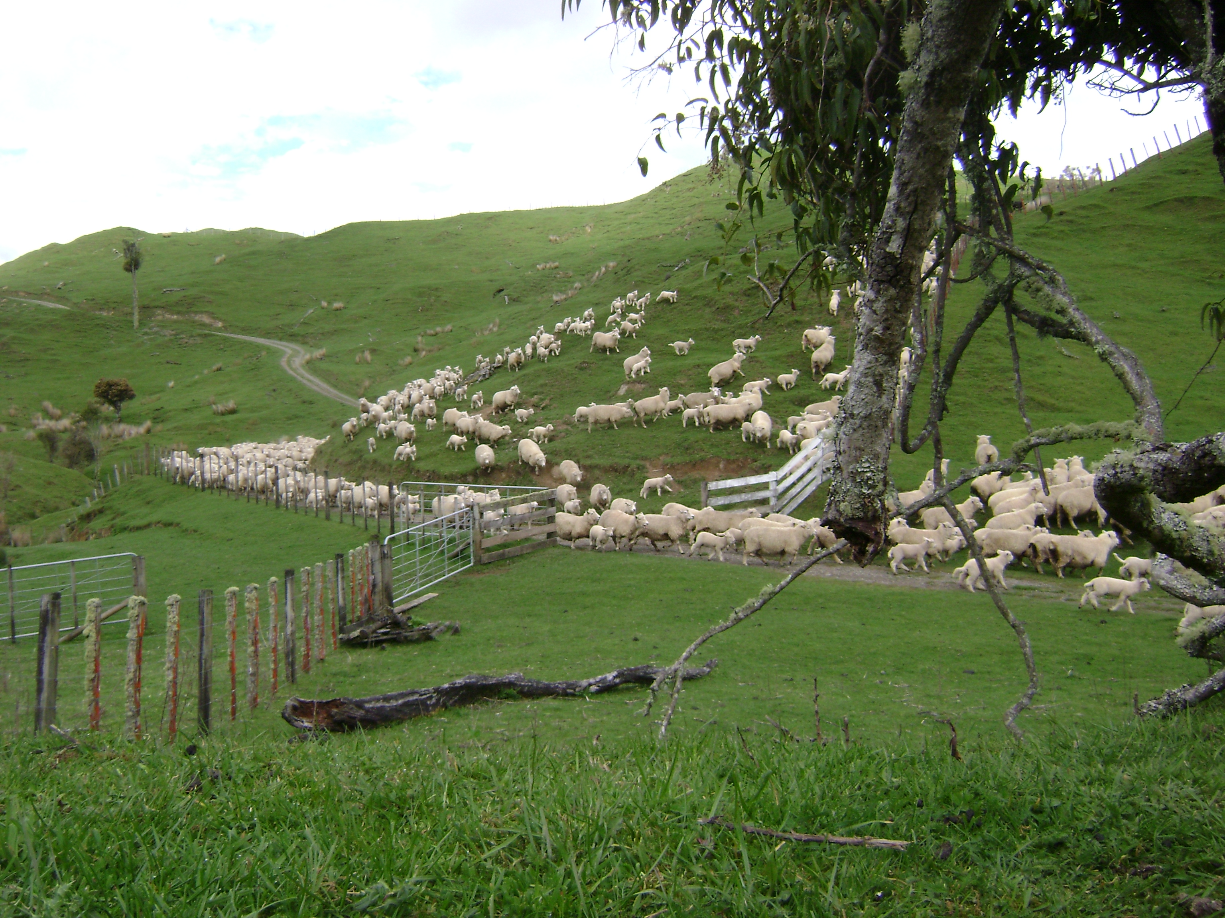
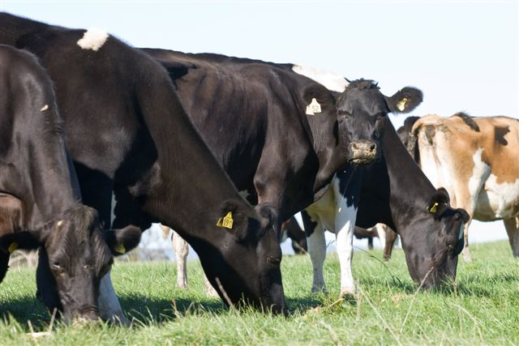
Maintaining Farm Profitability to Meet Environmental Requirements
Phil Journeaux

Slide 2
Topics for Discussion
Drivers of on-Farm Emissions
He Waka Eke Noa
New Technologies
Farm Level Modelling
Differentiating Farm Profitability
Case Studies
Carbon Taxes
What Farmers Need to Think About

Slide 3
What Drives On-Farm GHG Emissions
Amount of dry matter eaten – direct correlation with CH₄, strong correlation with N₂0
Protein level of the diet – N₂0
Amount of nitrogen fertiliser applied – produces more DM (CH₄/N₂0) some N₂0/CO₂ direct

Slide 4
What Drives Nitrate Leaching
Bit more complex:
Amount of dry matter eaten – relates to stocking rate and amount of urine deposited
Protein level of the diet
Amount of nitrogen fertiliser applied, & when
Type of livestock
Drainage characteristics of the soil
Rainfall

Slide 5
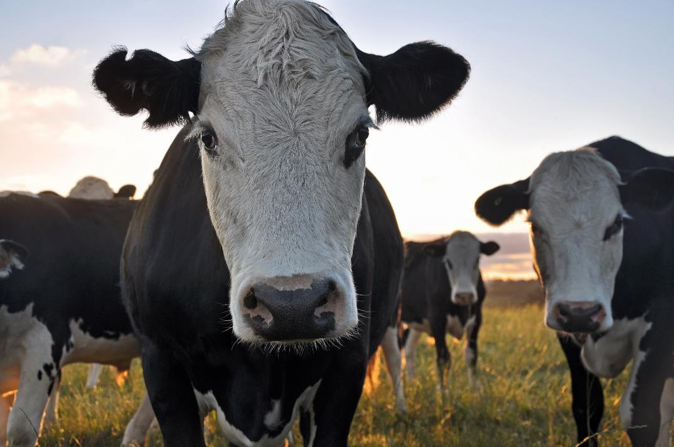
He Waka Eke Noa
Primary Sector Climate Action Partnership
www.hewakaekenoa.nz
Notes:
Step one is to calculate your farm’s emissions – ‘know your number’. When you know your baseline, you will be able to start incorporating emissions reductions into farm planning.

Slide 6
He Waka Eke Noa: milestones
Actions | Deadline
Guidance provided on how to measure and manage GHG emissions through farm planning | 1 January 2021
25% of farmers and growers know their annual total on-farm GHGs and have a written plan to manage emissions | 31 December 2021
100% of all farmers and growers know their annual total on-farm GHGs | 31 December 2022
Pilot farm accounting system completed | 31 December 2023
100% of farmers and growers have a written plan to measure and manage emissions | 31 December 2024
All NZ farms using farm-level accounting and reporting system for 2024 agricultural GHGs | 1 January 2025
Notes:
These milestones are now legislated in the Climate Change Response (Emissions Trading Reform) Amendment Act, June 2020

Slide 7
He Waka Eke Noa: the details
Main aspects being worked on
Farm-level price
Carbon sequestration regimes
On-farm accounting system
Consulting with farmers February 2022
Provide final plan to Climate Change Commission/Government May 2022
June 2022, Climate Change Commission reviews progress towards those milestones
Dec 2022, Ministers for Climate Change and Agriculture report to Govt with details of pricing mechanism
Notes:
Shows the logos of the 13 partner organisations involved, but there are many other organisations – including NZAGRC, providing input to He Waka Eke Noa’s work.

Slide 8
He Waka Eke Noa Options
Option1: On-farm cost: Farmer works out net emissions:
Methane + Nitrous oxide + CO₂ from Nitrogen fertiliser, less sequestration credits
Option 2: Processor Level Hybrid:
Processor collects tax on product processed, + nitrogen fertiliser purchased
Farmer enters a Emissions Management Contract - calculates sequestration credits &/or reductions in GHG emissions - receives payment for these
Pricing will be on a split gas basis – i.e. different price for methane and nitrous oxide

Slide 9
Processor Level vs On-Farm Cost
(Farm Level Gross)
 | 2025 |  | 2030 |  | 2050
 | Processor | On-Farm | Processor | On-Farm | Processor | On-Farm
Waikato/BoP Dairy | $6,607 | $6,195 | $21,452 | $20,428 | $233,174 | $222,045
Canterbury Dairy | $16,850 | $12,966 | $54,712 | $42,725 | $594,693 | $464,400
NI Hill Country S&B | $6,348 | $7,174 | $20,598 | $24,440 | $265,650 | $223,889
SI Hill Country S&B | $4,766 | $11,195 | $15,476 | $37,552 | $168,221 | $408,171
2025: $85/T @5% 2030: $138/T @10% 2050: $250/T @60%

Slide 10
He Waka Eke Noa work on sequestration
Permanent vegetation*
Indigenous vegetation: pre 1 Jan 2008
Minimum area of 0.25ha
Based on “additionality” and actively managed
Indigenous vegetation: post 1 Jan 2008
Minimum area 0.25ha
Riparian vegetation: post 1 Jan 2008
Minimum of 1m from edge of bank
Cyclical vegetation
Perennial cropland: post 1 Jan 2008
Minimum area of 0.25ha – horticulture & vineyards
Scattered forest:
Min 0.25ha and min 15 stems/ha
Includes shelterbelts
Excluded if >1ha, >30% canopy cover, >30m wide
Woodlots/tree-lots:
0.25 – 1ha in size, >30% canopy cover
*Must be predominantly indigenous woody vegetation

Slide 11
What new technologies are being developed?
Technology | When available | Maximum efficacy
Low-emitting sheep | 2-3 years | 10%?
Low-emitting cattle | >5 years | 10%?
Low N excreting cattle | Now in theory | ??
Methane vaccine | >10 years | 30%?
Methane inhibitors | 2-5 years | 30+%
Nitrification inhibitors | 3-5 years | 50+%
Low emission feeds (forage rape, fodder beet, plantain) | Available now | ?
Novel low emitting feeds/additives (e.g. GM ryegrass, seaweed) | ? | ?
Animal devices (e.g. methane destruction) | ? | ?
Notes:
Time to market and efficacy often unknown. Low methane sheep and inhibitors are the nearest to market. Vaccine works in a test tube but not in an animal. Low N excreting cattle still at proof of concept stage. One seaweed reduces emissions but question marks over acceptability and practicality. No published evidence that GM ryegrass reduces emissions.

Slide 12
Farm Level Emissions
Farm level modelling:
Average dairy farm 9.6 tonnes biological GHG/ha/year (range: 3.1 – 18.8t/ha/year)
Average sheep & beef farm 3.6t/ha/year (range: 0.16-7.1t/ha/year)
Intensity of emissions: kg CO₂e/kg product
Milk solids | Beef | Sheep meat | Goat meat | Venison
8.76 | 14.2 | 23.57 | 19.56 | 30.7

Slide 13
Farm Modelling
 | Farm 1 |  |  | Farm 2 |  |  | Farm 3
 | Change in GHGs (%) | Change in EBITDA (%) | Change in N Leaching (%) | Change in GHGs (%) | Change in EBITDA (%) | Change in N Leaching (%) | Change in GHGs (%) | Change in EBITDA (%) | Change in N Leaching (%)
Reduce SR 10% - no productivity improvement | -8% | -35% | -3% | -11% | -18% | -9% | -10% | -17% | -11%
Reduce SR 10% - improve productivity | -6% | 33% | -5% | -6% | 7% | -11% | -4% | 0% | -5%
Take out all Nitrogen Fertiliser | -7% | -5% | -14% | -16% | -7% | -26%
Take out 1/2 Nitrogen Fertiliser |  |  |  |  |  |  | -3% | -1% | -8%
Take out bought-in supplements | -10% | -21% | -8% | -6% | -1% | -7% | -7% | -1% | 0%
Plant 10% of farm in Gold Kiwifruit | -9% | 211% | -3%
Plant 13% of farm in Green Kiwifruit | -10% | 130% | -11%
Plant 10% of farm in pine trees | -39% | -7% | -5% | -31% | -8% | -7%
Plant 30% of farm in pine trees | -106% | -55% | -24% | -100% | -34% | -20%

Slide 14
Farm modelling
On-farm system change can impact on GHG emissions, but limited:
Generalisation: 2-10% reduction
Variable impact on profitability
Current key tool is reduce stocking rate – but need to improve per animal productivity to maintain profitability
Running lower stocking rate/higher per animal performance farms will require an improvement in overall farm management. Which could take years.
Each. Farm. Is. Different.
https://www.agfirst.co.nz/wp-content/uploads/2020/09/Achieving-Zero-Carbon-Act-Reduction-Targets-on-Farm-AGF.pdf

Slide 15
The Case Study Farms
 | Case Study Farm#1 |  | Case Study Farm#2
Total Area (ha) | 329 |  | 303
Effective Area (ha) | 308 |  | 164
Cows Wintered | 802 |  | 410
Milksolids Production (kg MS) | 216,915 |  | 132,000
Kg MS/Cow | 293 |  | 326
Kg N/Effective ha | 145 |  | 97

Slide 16
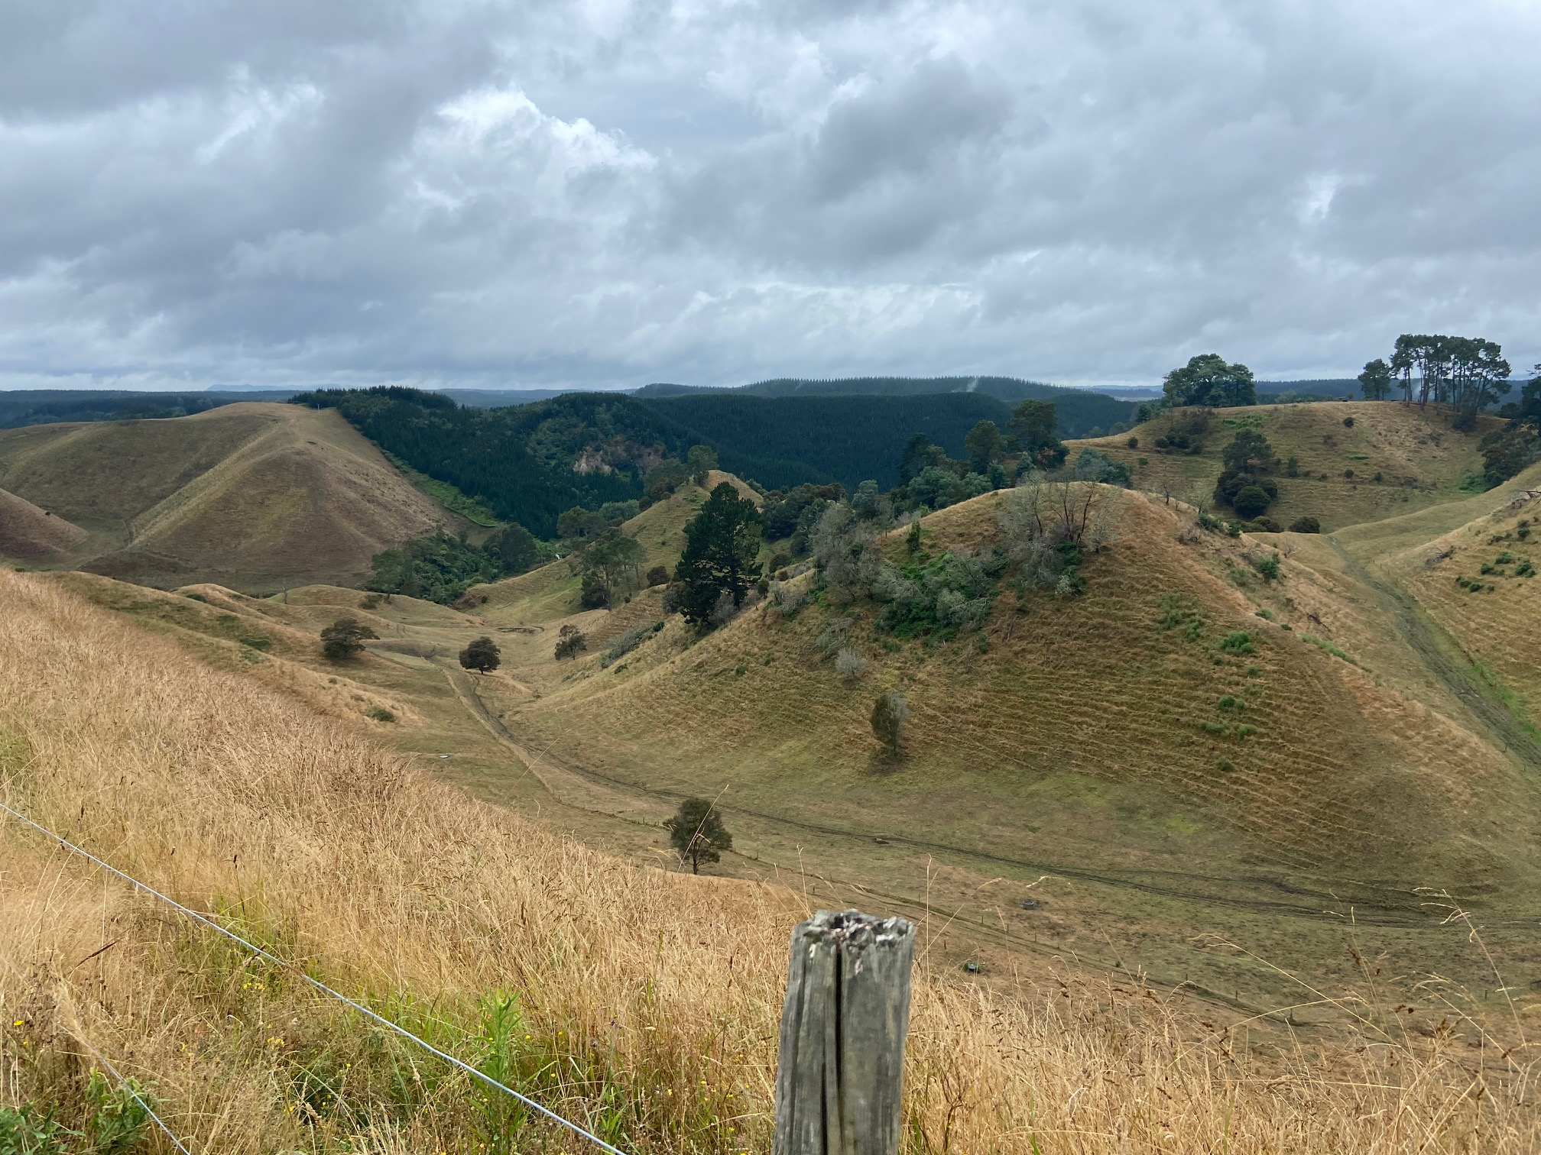
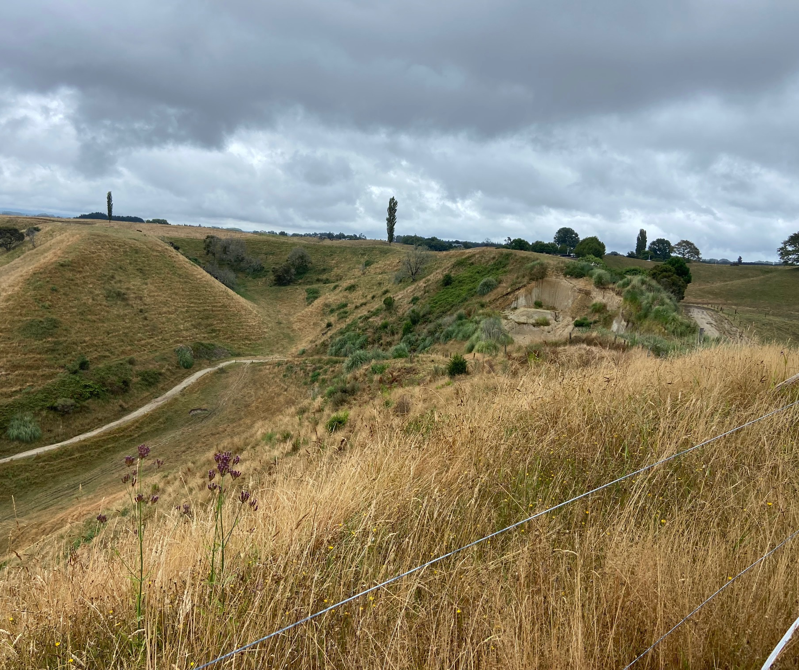
What Does Steep Look Like

Slide 17
Differentiating Farm Profitability
North Island Hill Country farm
Block | Ha | LUC | kg DM/ha | SU/ha
Steep | 234 | 6-8 | 4,650 | 5.5
Rolling | 238 | 3-4 | 7,635 | 9.7
Flat | 53 | 2-3 | 10,920 | 14.9
Total | 525 | Weighted av: | 6,635 | 9.0
Use Farmax modelling to differentiate profitability
 | EBITDA ($/ha)
Total Farm | $372
Steep | $93
Rolling/Flat | $596

Slide 18
Differentiating Farm Profitability
Case Study Farm#1
Case Study Farm#2
 | ha | Estimated TDM/ha
Dairy Farm | 308 | 9.1
Steep | 83 | 4.5
Rest | 225 | 10.8
 | ha | Estimated TDM/ha
Dairy Farm | 164 | 11.5
Steep | 69 | 6.7
Rest | 95 | 15.0
 | EBITDA ($/ha)
Farm | $1,076
Steep | $186
Rest | $1,404
 | EBITDA ($/ha)
Farm | $2,589
Steep | $853
Rest | $3,850

Slide 19
Planting Area in Trees: Farm#1
 | Effective Area (ha) | Area in Forestry (ha) | Cows wintered | Cows/ha | Total Milksolids (kg) | kg MS/cow | kg MS/ha
Base | 308 | 0 | 802 | 3.0 | 216,950 | 293 | 704
Plant Trees | 238 | 70 | 466 | 2.0 | 153,964 | 358 | 647
Farm #1 | EBITDA ($/ha) | % Change | Total Biological GHGs (T/ha) | % Change | N Leached (kg/ha) | % Change
Base | $1,025 |  | 7.8 |  | 51
Plant Trees - dairy only | $1,979 | 93% | 6.7 | -14% | 42 | -18%
Average across whole farm including pines | $1,622 | 58% | 5.2 | -33% | 33 | -35%
Average across whole farm including natives | $1,359 | 33% | 5.2 | -33% | 33 | -35%

Slide 20
Planting Area in Trees: Farm#1
 | Old | New | With pines | Natives
Supplements (T DM) | 618 | 72
kg N/ha | 137 | 109
Total EBITDA | $315,700 | $471,002 | $499,702 | $418,502

Slide 21
Planting Area in Trees: Farm#2
 | Effective Area (ha) | Area in Forestry (ha) | Cows wintered | Cows/ha | Total Milksolids (kg) | kg MS/cow | kg MS/ha
Base | 165 | 0 | 400 | 2.4 | 141,050 | 363 | 855
Plant Trees | 115 | 50 | 287 | 2.5 | 107,743 | 379 | 937
 | EBITDA ($/ha) | % Change | Total Biological GHGs (T/ha) | % Change | N Leached (kg/ha) | % Change
Base | $2,083 |  | 5.8 |  | 36
Plant Trees - dairy only | $2,798 | 34% | 6.0 | 3% | 36 | 0%
Average across whole farm including pines | $2,074 | 0% | 4.2 | -28% | 26 | -28%
Average across whole farm including natives | $1,723 | -17% | 4.2 | -28% | 26 | -28%

Slide 22
Planting Area in Trees: Farm#2
 | Old | New | With pines | Natives
Supplements (T DM) | 139 | 139
kg N/ha | 96 | 111*
Total EBITDA | $343,695 | $321,770 | $342,270 | $284,270
*3 Tonne N less across whole farm

Slide 23
Reducing Stocking Rates – A Cautionary Tale
If reducing stocking rates – grazing management must step up in order to maintain pasture quality – otherwise could well end in tears

Slide 24
Working out the Carbon Tax
General approach is:
A + B – C x price x price exposure
Or more nuanced is:
A + B + b – C x price x price exposure
Where:
A = Methane
B= Nitrous Oxide
b = CO₂ from nitrogen fertiliser
C = sequestered carbon (as CO₂e)
If can’t offset methane with sequestered carbon, formula becomes:
A + (B + b – C) x price x price exposure
If possible – denominate both sides in $$
A ($ methane) + B ($ N₂O + CO₂ from fert) – C ($ sequestration) = $

Slide 25
Working out the Carbon Tax#2
Hypothetical farm:
 | T CO₂e
A (Methane) | 1,200
B (Nitrous Oxide) | 300
b (CO₂ from N Fertiliser) | 15
C (Sequestered Carbon) | 250
Look at it differently, using $
A+B = 1,515 tonnes
@$85/5%, Tax = $6,439
Sell Sequestered Carbon (250 T @ $85) = $21,250
A+B-C = -$14,811
A+B-C = 1,265 Tonnes
@$85/5%, Tax = $5,376
A ($ methane) + B ($ N₂O + CO₂ from fert) – C ($ sequestration) = $

Slide 26
Case Study Farm – Carbon Tax
Farm #1 | Carbon Tax
 | Using Tonnes |  | Using Dollars
 | 2025 | 2030 | 2025 | 2030
Base | $10,210 | $33,153 | $10,210 | $33,153
Plant Trees - dairy only | $6,777 | $22,005 | $6,777 | $22,005
Average across whole farm including pines | $585 | $1,901 | -$117,057 | -$179,043
Average across whole farm including natives | $4,742 | $15,398 | -$40,630 | -$44,069
Farm #2 | Carbon Tax
 | Using Tonnes |  | Using Dollars
 | 2025 | 2030 | 2025 | 2030
Base | $4,067 | $13,207 | $4,067 | $13,207
Plant Trees - dairy only | $2,933 | $9,522 | $2,933 | $9,522
Average across whole farm including pines | -$1,490 | -$4,839 | -$85,521 | -$134,084
Average across whole farm including natives | $2,754 | $4,802 | -$26,138 | -$37,674

Slide 27
What do Farmers need to Think About?
Nitrogen
Know your N leaching number
Can’t apply more than an average across whole farm of 190kgN/ha – includes forage crops
Consider your autumn/winter grazing management
Know what the Regional rules are
All this needs to be included in your FEP
GHGs
Know your GHG number and benchmark this
Think/plan through what options you have to mitigate &/or offset GHGs
Wait until we know what the farm level prices are, and what the rules are
Need to include GHG management in your FEP

Slide 28
Information on GHGs
www.agmatters.nz

