Slide 1
Resilient Farming Futures
Due to multiple layers on many slides, view using presentation mode
Protecting the welfare of animals, people and Papatūānuku
Dr. B Helen Beattie, Managing Director
Veterinarians for Animal Welfare Aotearoa
M | 021 1226796 E | info@vawa.co.nz W | vawa.co.nz

Slide 2
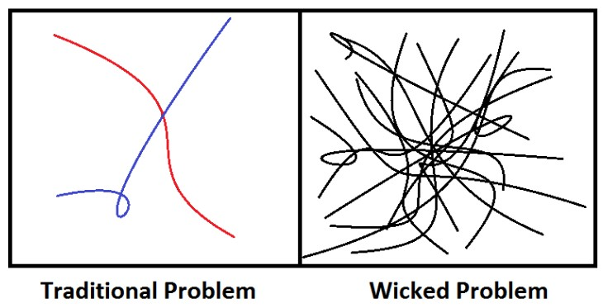
Principles
Ecosystem / Papatūānuku
Interconnectedness of welfare
One Health | One Welfare frameworks
Te Ao Māori
Wicked problems (predicament)
Simple outcome
Complicated pathway
Solution vs response
Human behaviour change (HBC)
Logic bullying vs HBC narrative
Environment
Animals
People
‘We don’t have 200 years’ – TK
‘The economy is wholly a subsidiary of the environment, not the reverse.’
Herman Daly – ecological economist
‘We need to put the environment in front of the economy.’
Pa Ropata - legend
Dr. B Helen Beattie, Managing Director
Veterinarians for Animal Welfare Aotearoa
M | 021 1226796 E | info@vawa.co.nz W | vawa.co.nz
Notes:
Without environmental justice , there is not social justice.
Despite the disagreement over the definition of wicked problems, some consensus exists surrounding the characteristics of the phenomenon.
For example, wicked problems have three similarities:
they change over time (Weber & Khademian, 2008),
social scientists are uncertain about their root causes due to social complexity (Lazarus, 2009), and
stakeholders hold different values regarding the challenges, which often causes conflict (Conklin, 2006).
In addition, the properties of wicked problems often demand collective action across several sectors to create transformative and impactful change throughout the system (Waddock, 2013).
Further, the action of individuals to combat wicked problems has very little impact without the collective and coordinated action with others, which is why multi-stakeholder initiatives play an important theoretical role in the dissertation (Batie, 2008; Conklin, 2006; Weber & Khademian, 2008).

Slide 3
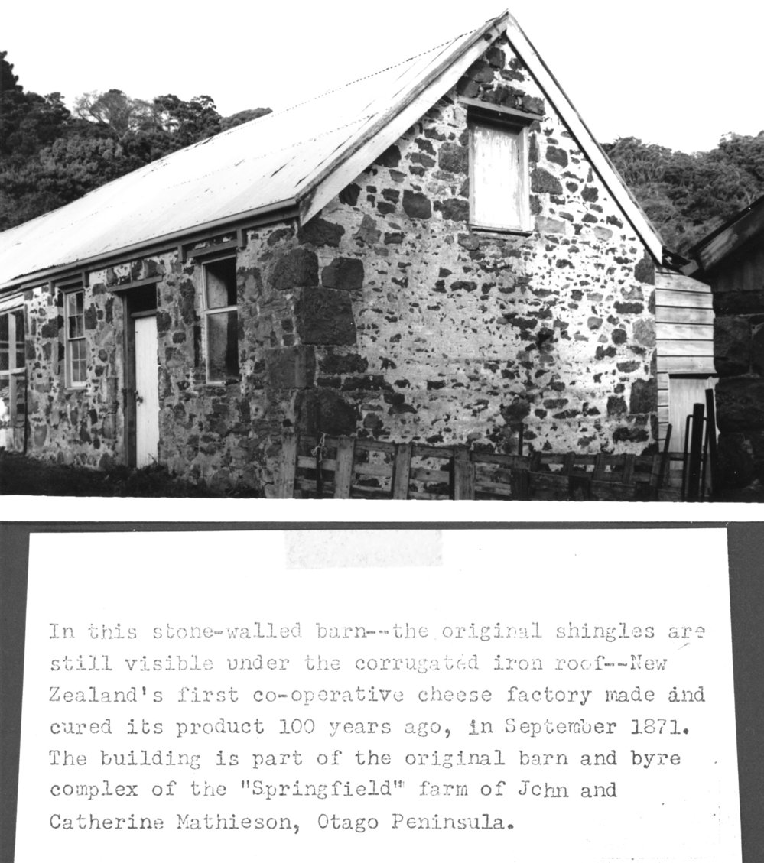
Fun fact
"In this stone walled barn, the original shingles are still visible under the corrugated iron roof, New Zealand's first co-operative cheese factory made and cured its product 100 years ago, in September 1871.
The building is part of the original barn and byre complex of the "Springfield" farm of John and Catherine Mathieson, Otago Peninsula".
https://tamiro.massey.ac.nz/nodes/view/284#:~:text=First%20New%20Zealand%20Co%2Doperative%20Cheese%20Factory%2C%20Otago%2C%201871,-collapse&text=%22In%20this%20stone%20walled%20barn,years%20ago%2C%20in%20September%201871.
Dr. B Helen Beattie, Managing Director
Veterinarians for Animal Welfare Aotearoa
M | 021 1226796 E | info@vawa.co.nz W | vawa.co.nz
Notes:
https://tamiro.massey.ac.nz/nodes/view/284#:~:text=First%20New%20Zealand%20Co%2Doperative%20Cheese%20Factory%2C%20Otago%2C%201871,-collapse&text=%22In%20this%20stone%20walled%20barn,years%20ago%2C%20in%20September%201871.

Slide 4
Animal Welfare | MIA
How many times did AW get meaningfully mentioned today?
Quick Quiz | 5 seconds on each
Can you define animal welfare? (go on – try!)
Bonus question – what about sentience? Can you define it?
Do you know about the Five Freedoms?
What about the Five Domains?
Are you good at managing your animals’ welfare?
Bonus question – if you answered 4 or 5 to Q5, did you also answer ‘5’ to questions 1, 2 and 4?
1 = no
3 = maybe
5 = yes
Dr. B Helen Beattie, Managing Director
Veterinarians for Animal Welfare Aotearoa
M | 021 1226796 E | info@vawa.co.nz W | vawa.co.nz

Slide 5
Animal welfare | what is it?
The intrinsic welfare of animals
The discipline of animal welfare
Science
Ethics
Policy & Law
Credit: Dr. Kat Littlewood, BVSc (Dist), PGDipVCS (Dist), PhD, AFHEA, FANZCVS (AWSEL)
Maddie’s Insights: Five Domains of Animal Care https://www.youtube.com/watch?v=IL-b0eJ2Tac
Dr. B Helen Beattie, Managing Director
Veterinarians for Animal Welfare Aotearoa
M | 021 1226796 E | info@vawa.co.nz W | vawa.co.nz
Notes:
Refer you to Kat Littlewoods presentation - https://www.youtube.com/watch?v=IL-b0eJ2Tac

Slide 6
Animal welfare
The intrinsic welfare of animals
Animals ‘having welfare’ is predicated on them having the capacity to have experiences that matter to them i.e., they are sentient
Jeremy Bentham - 1789
"The question is not, Can they reason? nor,
Can they talk? but, Can they suffer?“
Pa Ropata – 2024
‘Cows and sheep are not stock units; they are living, breathing animals.’
‘What is animal sentience?
The National Animal Welfare Advisory Committee (NAWAC) understands animal sentience to mean that animals have emotions, feelings, perceptions, and experiences that matter to them. These can be negative (such as pain or boredom) as well as positive (such as pleasure or comfort).
We don’t know whether animals’ emotions, feelings, and experiences are similar to those of humans. We also don’t know if they are felt with the same intensity. But they matter to individual animals and have an impact on their welfare.’
Dr. B Helen Beattie, Managing Director
Veterinarians for Animal Welfare Aotearoa
M | 021 1226796 E | info@vawa.co.nz W | vawa.co.nz
Notes:
Animal welfare
animals are sentient
capacity for experiences that matter to them
physical & psychological welfare
animals can suffer and thrive
assess via 5D
examine and learn via discipline
Notably, underpinning legislation, that is based on minimum standards and prevention of suffering and serious negative welfare impacts, does not provide a life worth living, nor a good life. Good animal welfare, and a good life, can be achieved only when animals can also have experiences that they find rewarding and positive. Edgar et al (2013) state,
“Farm animals can be said to have a 'good life' if their quality of life is substantially higher than the current legal minimum and includes positive experiences of pleasure. In commercial farms, animals can be provided with different resources such as bedding, exercise areas and enrichment objects.”
‘A Good Life’ then for an animal can only be achieved when the animal has opportunities over and above the minimum requirements. It requires more than merely limiting the worst of pain and distress (suffering) and needs to include positive welfare opportunities and resources that are valued by the animal. Edgar JL, Mullan SM, Pritchard JC, McFarlane UJC, Main DJC. Towards a 'Good Life' for Farm Animals: Development of a Resource Tier Framework to Achieve Positive Welfare for Laying Hens. Animals 2013, 3, 584-605

Slide 7
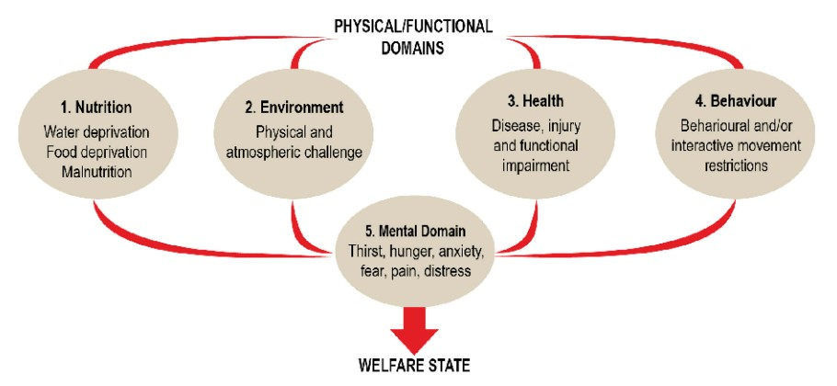
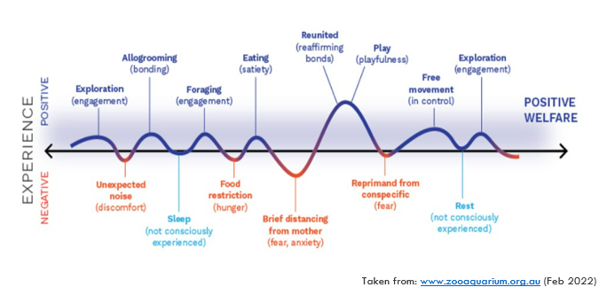
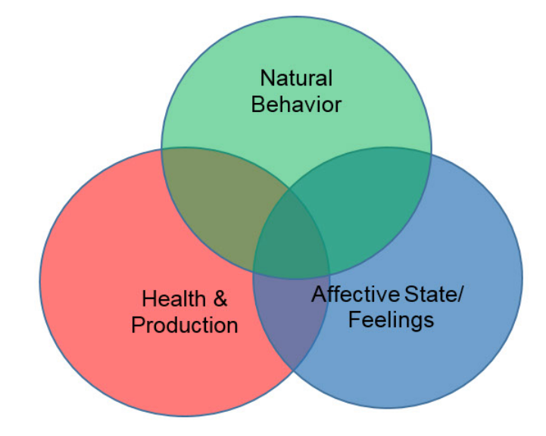
Animal welfare
2. The discipline of animal welfare
Science
Five Freedoms
Five Domains
Welfare Worms
A Good Life
Fraser’s model
Dr. B Helen Beattie, Managing Director
Veterinarians for Animal Welfare Aotearoa
M | 021 1226796 E | info@vawa.co.nz W | vawa.co.nz
Notes:
AWS used to understand animals’ intrinsic welfare
We use various frameworks/models to explain these

Slide 8
Animal welfare | interaction with policy and law
ALNWL
A Good Life
Minimum standards
The law limits only the worst of suffering
Positive welfare
Subjective | Individual |
Preferences | Choice | Quirks
Ties to sentience and the Five Domains
(not ‘Freedom from…’)
Dr. B Helen Beattie, Managing Director
Veterinarians for Animal Welfare Aotearoa
M | 021 1226796 E | info@vawa.co.nz W | vawa.co.nz
Notes:
Notably, underpinning legislation, that is based on minimum standards and prevention of suffering and serious negative welfare impacts, does not provide a life worth living, nor a good life. Good animal welfare, and a good life, can be achieved only when animals can also have experiences that they find rewarding and positive. Edgar et al (2013) state,
“Farm animals can be said to have a 'good life' if their quality of life is substantially higher than the current legal minimum and includes positive experiences of pleasure. In commercial farms, animals can be provided with different resources such as bedding, exercise areas and enrichment objects.”
‘A Good Life’ then for an animal can only be achieved when the animal has opportunities over and above the minimum requirements. It requires more than merely limiting the worst of pain and distress (suffering) and needs to include positive welfare opportunities and resources that are valued by the animal. Edgar JL, Mullan SM, Pritchard JC, McFarlane UJC, Main DJC. Towards a 'Good Life' for Farm Animals: Development of a Resource Tier Framework to Achieve Positive Welfare for Laying Hens. Animals 2013, 3, 584-605
FAWC 2009 report:
65. Claims that animals enjoy a standard of welfare higher than the legal minimum ought to be verified independently to protect the rights of consumers, farmers and retailers. Such claims are made regularly by various actors in the food supply chain.
There is great potential for confusion amongst consumers when animal products are differentiated according to their welfare provenance, especially when it is unclear how welfare has been assessed or which body has set the standard.
In all assurance schemes, independent audit is necessary to ensure compliance with the scheme’s standards but for a higher level of welfare that is equivalent to a good life, FAWC believes that the technical standards themselves should be approved independently to ensure that the market is transparent for supplier and purchaser alike.

Slide 9
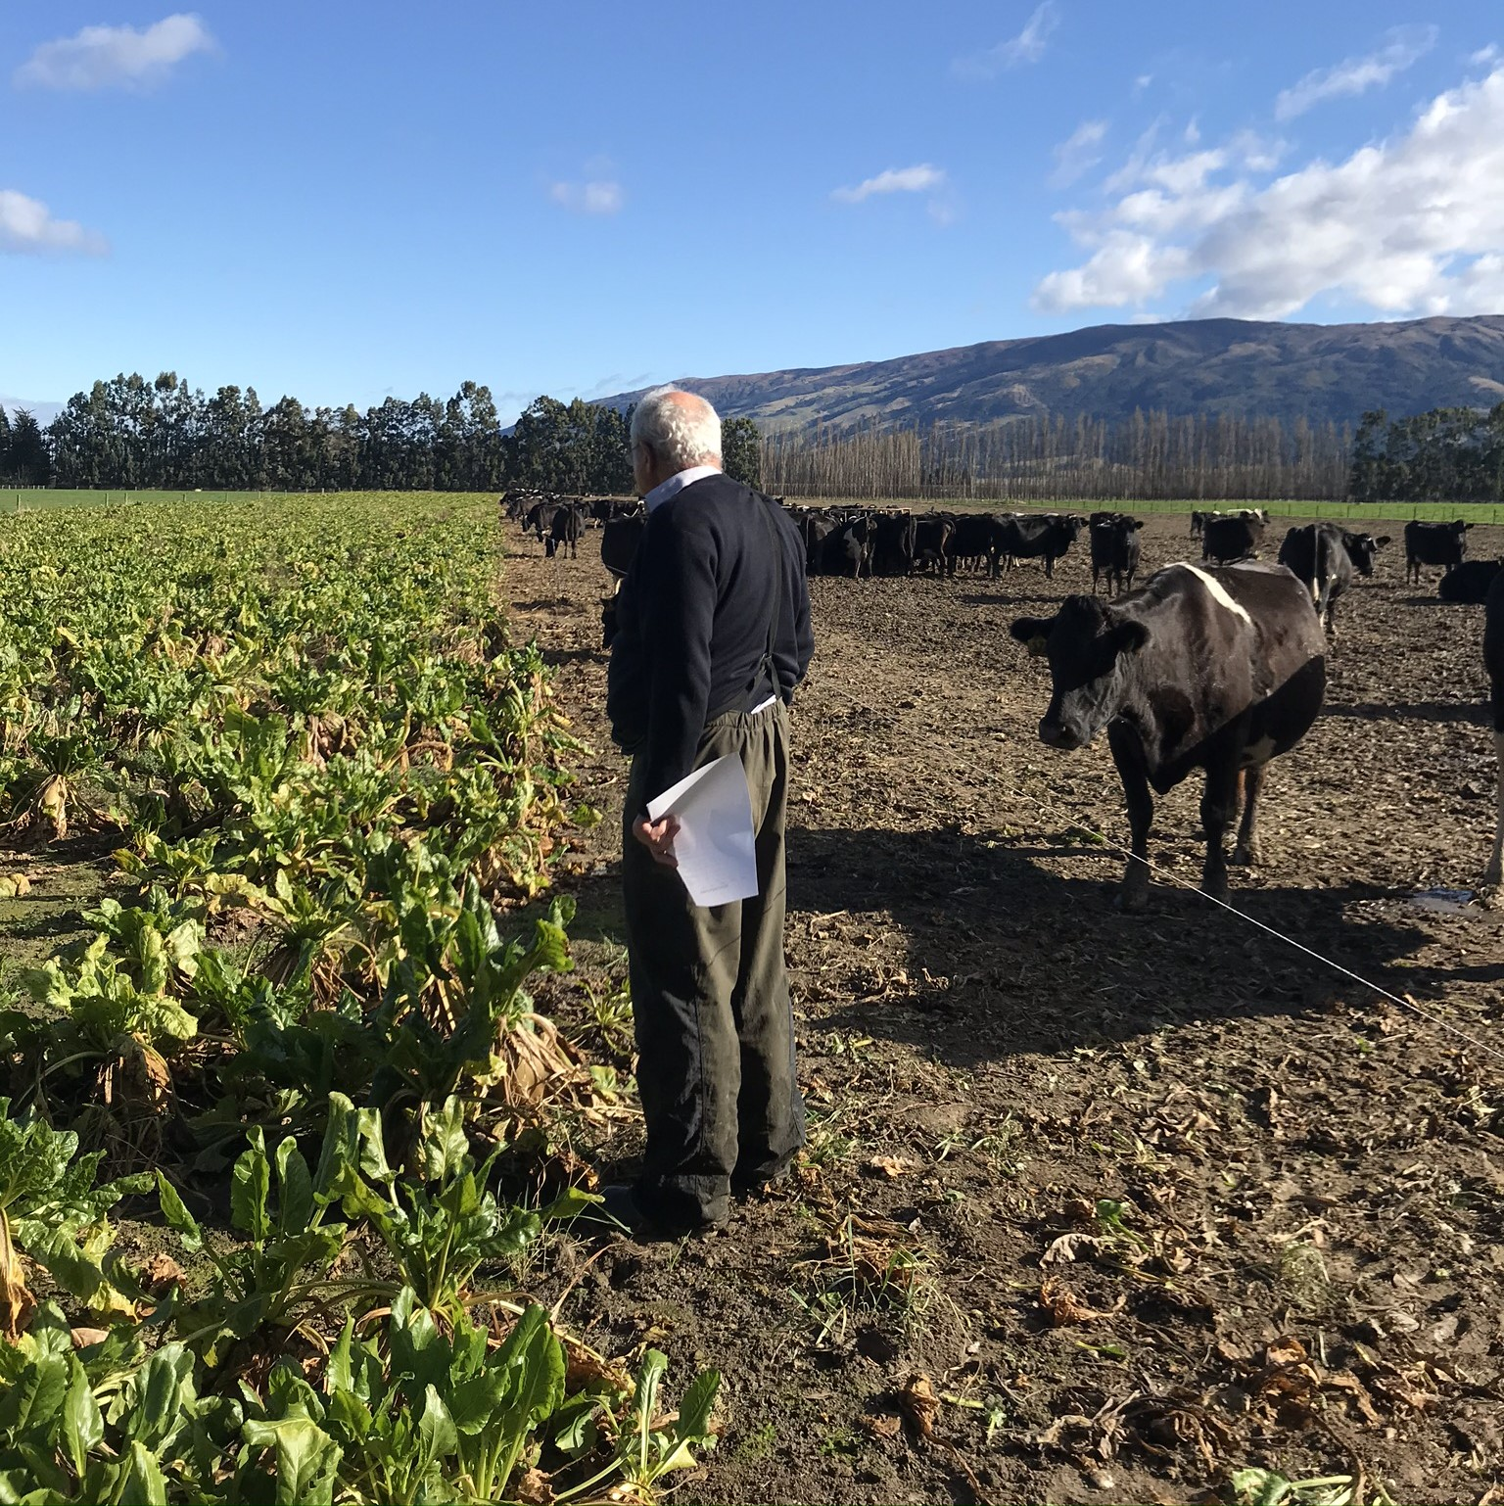
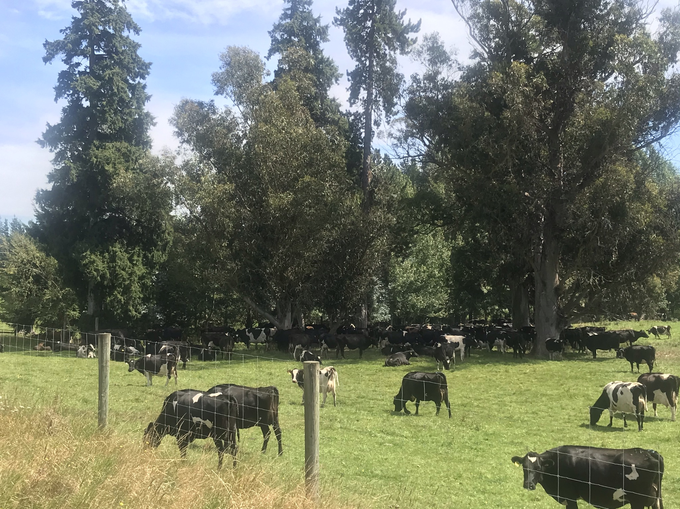
The connectedness of welfare
Are cows’ needs being met including opportunities to have positive welfare experiences?
Is environmental welfare protected?
Are people safe and contented?
Is there robust on-farm assurance using for animals, the Five Domains framework?
Should banks lend money?
Should processors pick up?
Should consents have been given?
Should fertiliser/seed be sold?
Crops and calves
Dr. B Helen Beattie, Managing Director
Veterinarians for Animal Welfare Aotearoa
M | 021 1226796 E | info@vawa.co.nz W | vawa.co.nz
Notes:
Ideally - add calves to system
No bare land nor use of pesticides and tillage

Slide 10
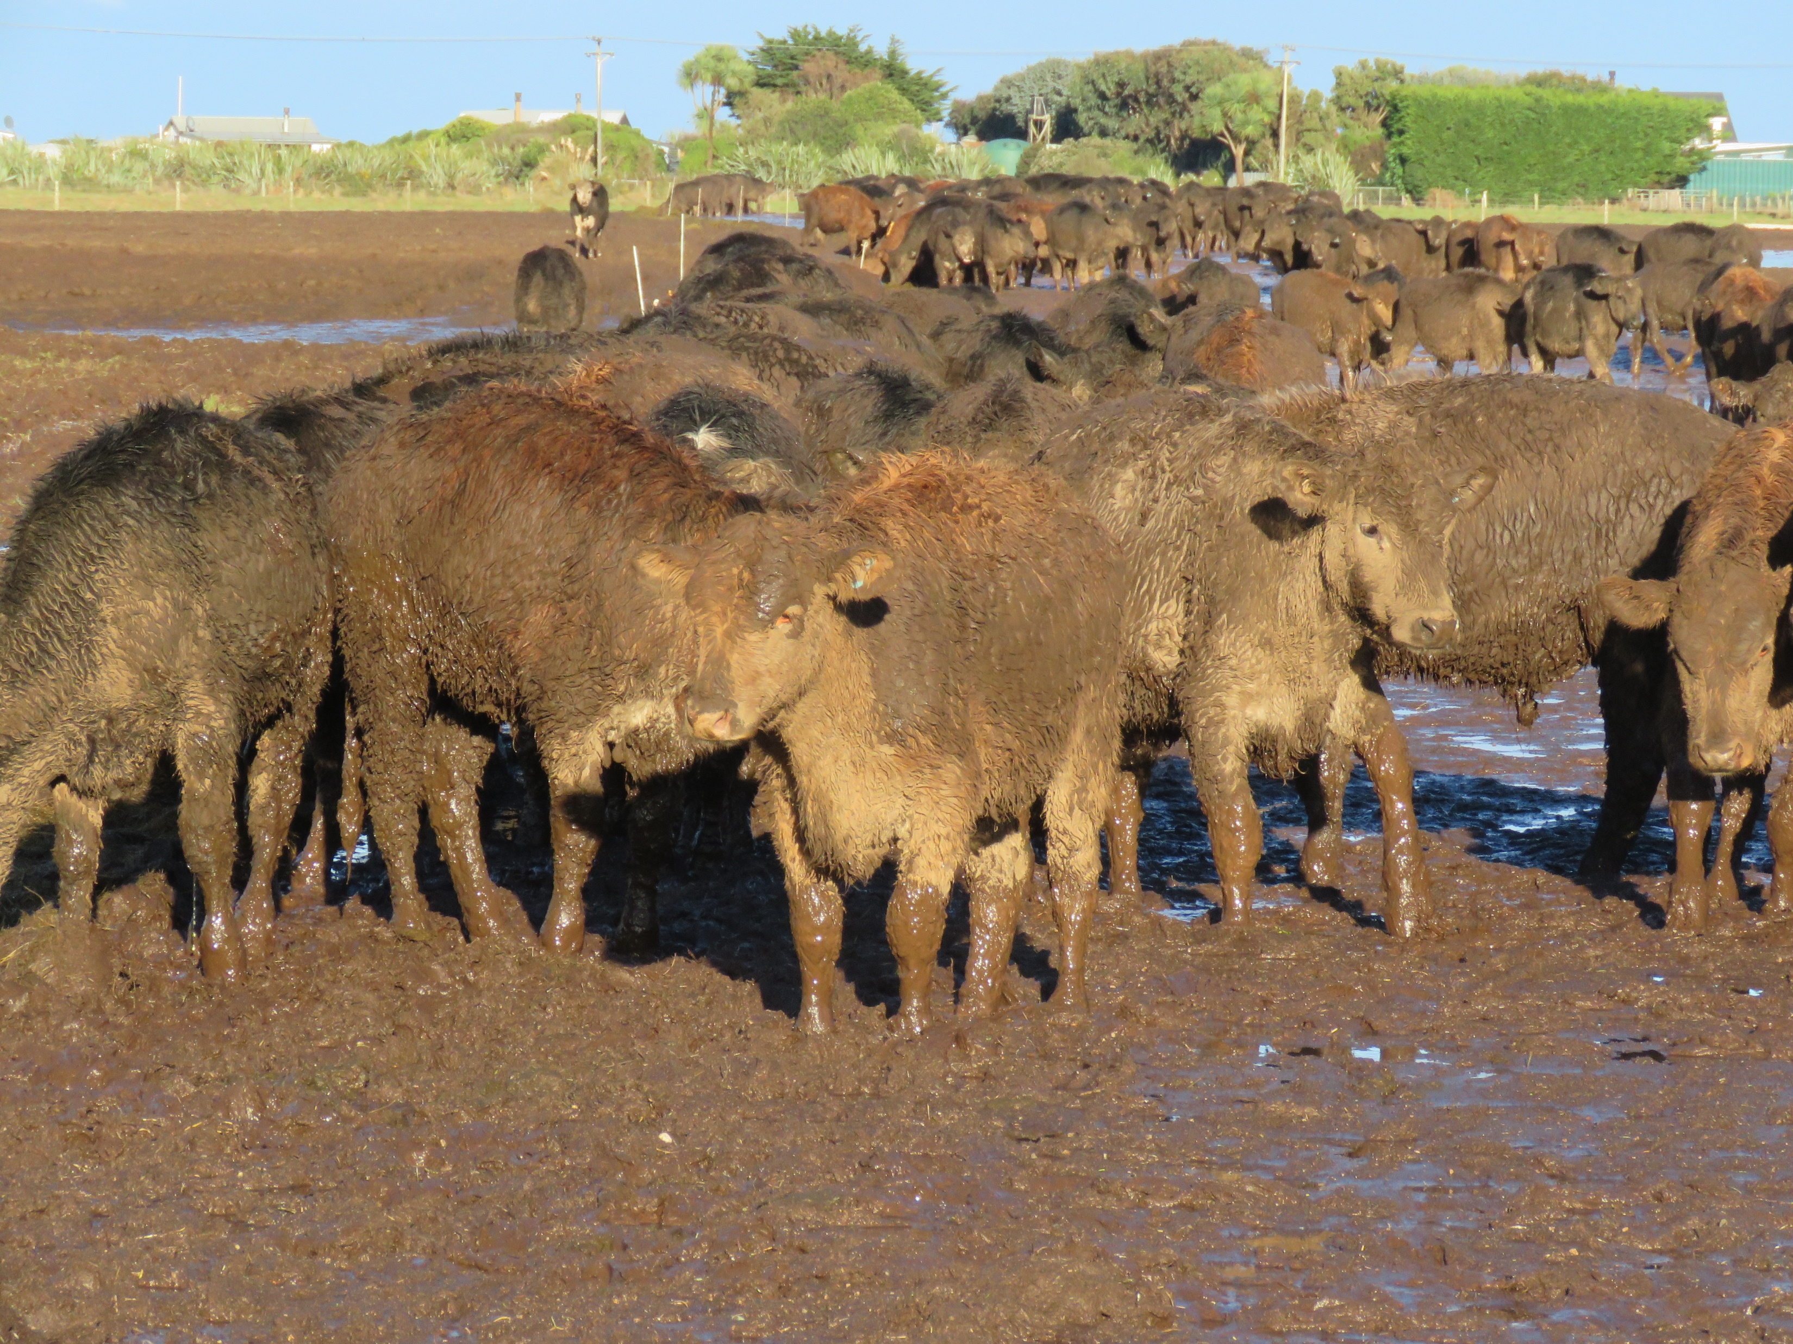
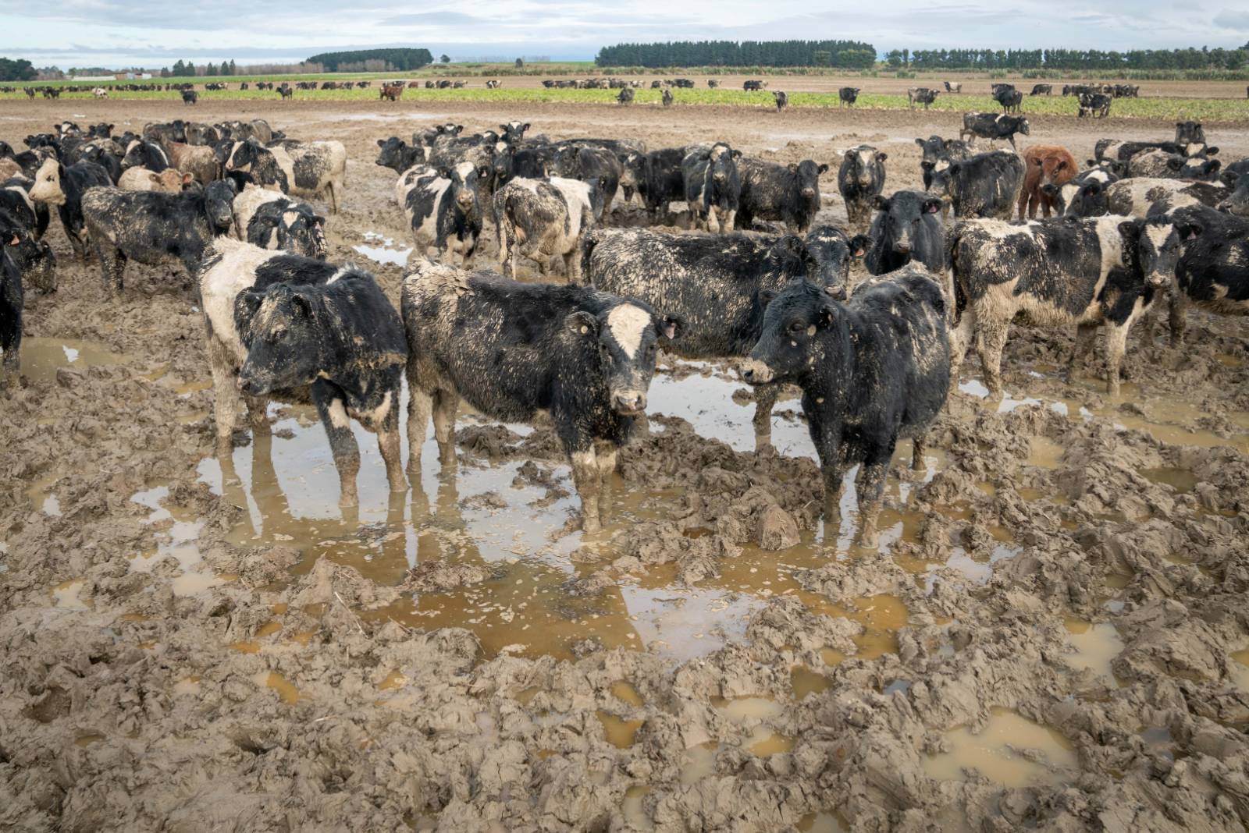
The connectedness of welfare
Question: does the Act help or hinder our animals?
Answer: if compliance was enforced (and Codes didn’t undermine), it’d be super great. As it is, it’s OK – but we have wicked problems to deal with (e.g. cows on mud and shadeless farms).
Dr. B Helen Beattie, Managing Director
Veterinarians for Animal Welfare Aotearoa
M | 021 1226796 E | info@vawa.co.nz W | vawa.co.nz

Slide 11
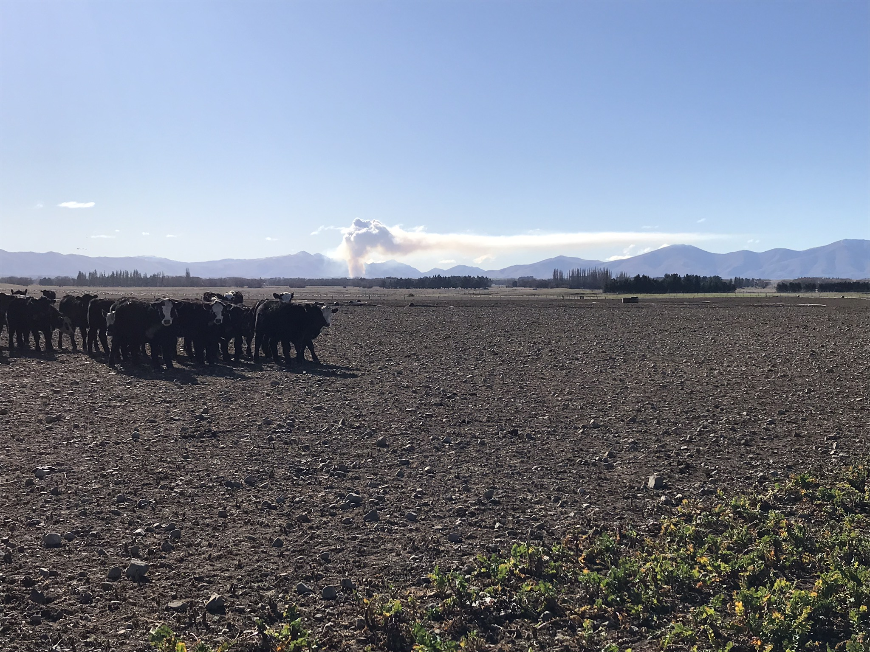
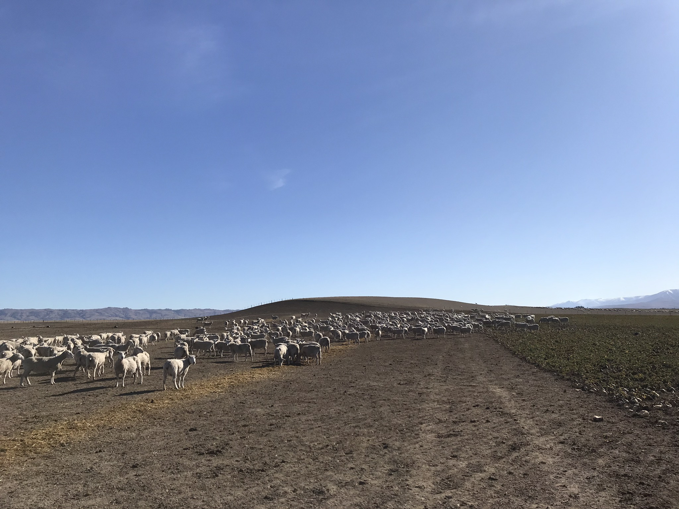
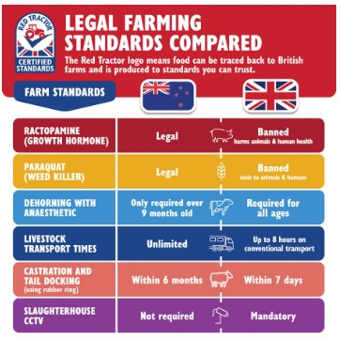
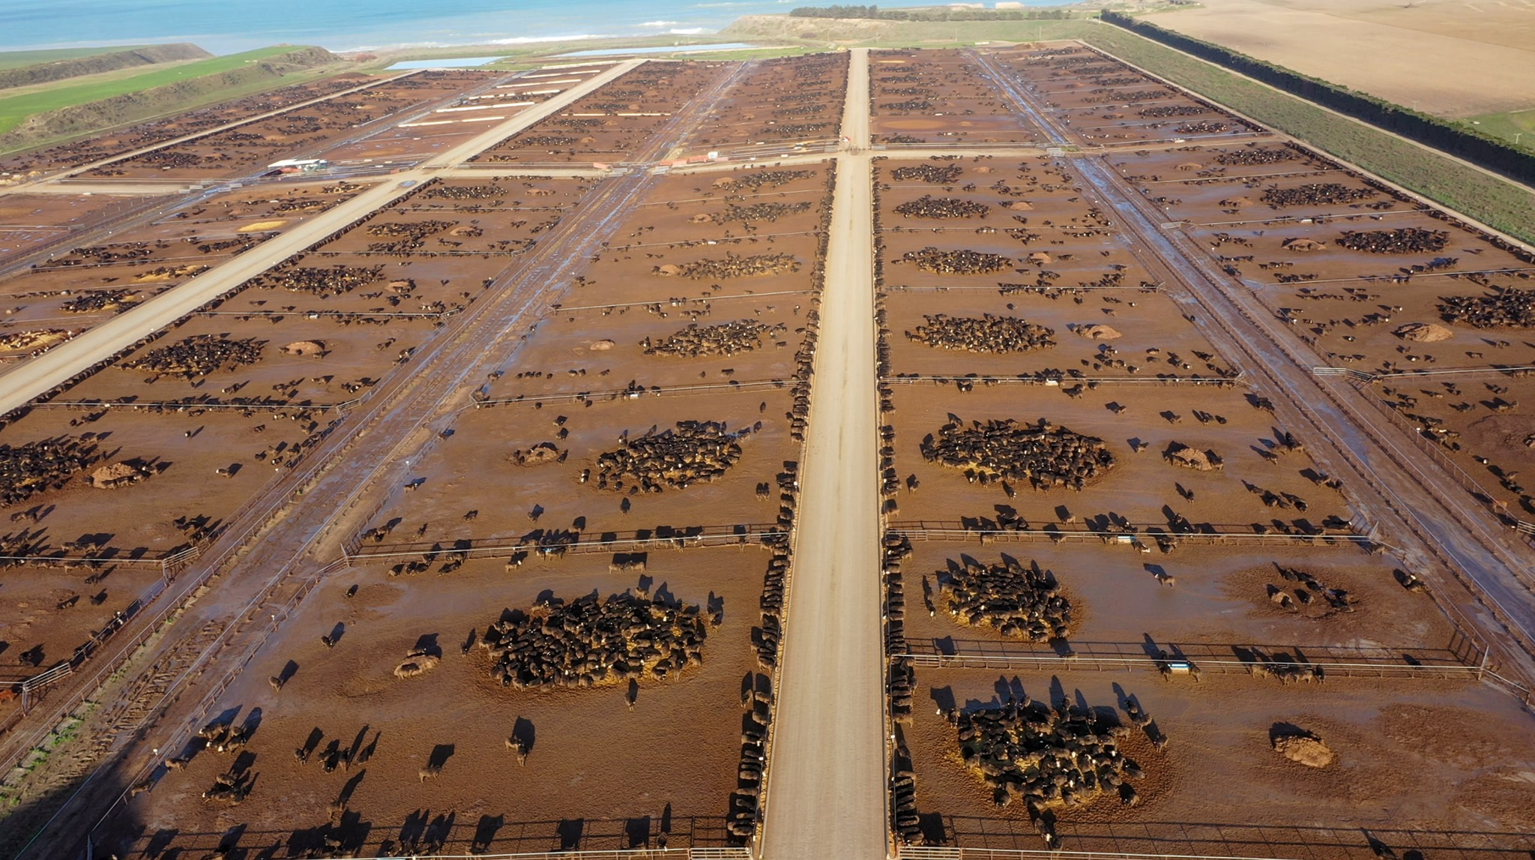
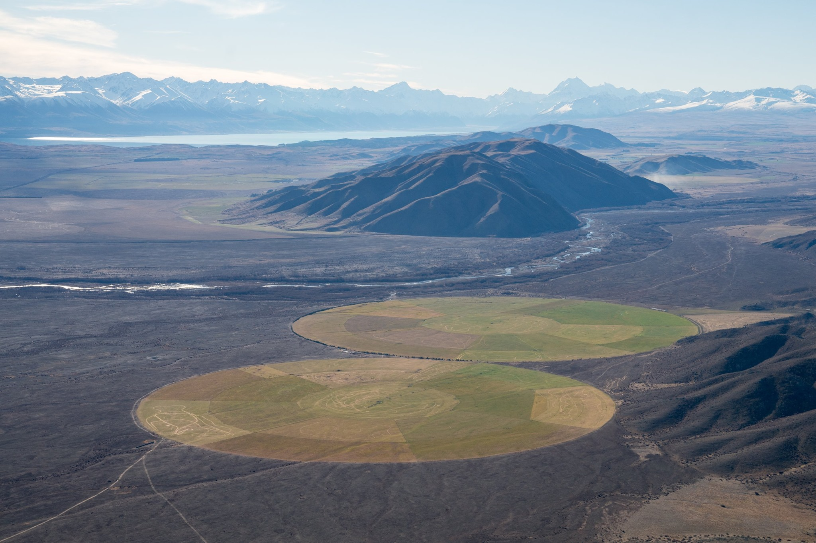
The connectedness of welfare
NOT YOUR FARM? NOT YOUR PROBLEM?
THIS IS PART OF YOUR IINDUSTRY.
THIS AFFECTS NEW ZEALAND’S REPUTATION.
THIS IS YOUR MOKO’S FUTURES BEING TRADED.
Dr. B Helen Beattie, Managing Director
Veterinarians for Animal Welfare Aotearoa
M | 021 1226796 E | info@vawa.co.nz W | vawa.co.nz
Notes:
Consider also the scale of the shade-less cattle beast scenario in different settings.
There’s no hard data on either the hectares of cropped land used for IWG, nor an accurate number on farms with insufficient shade/shelter.
However, driving around Canterbury, the Mackensie Country, Central Otago (Māniatoto, Omarama, Dunstan) gives a fair indication that the number is high.
Arguably, this is in breach of our Animal Welfare Act, through section 4b of the PHB, that states animals need “adequate shelter”

Slide 12
Consumers
Regulators
Farmers
Government
Consultants
Farming/sector organisations
Territorial Authorities
Banks
Fertiliser companies
Drivers
Veterinarians
Society
Seed merchants
Assurance
Processors
Supply (& user) chain
Dr. B Helen Beattie, Managing Director
Veterinarians for Animal Welfare Aotearoa
M | 021 1226796 E | info@vawa.co.nz W | vawa.co.nz
Notes:
So the actors – here’s a few; this isn’t comprehensive.
The point is, there are a lot of players that need to collaborate, and or show leadership to make the change that is necessary.
It’s the whole …

Slide 13
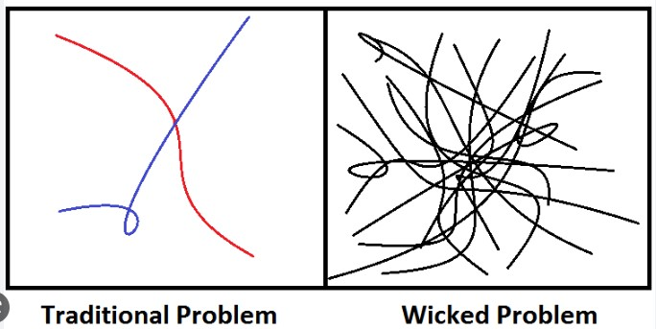
All those actors and more and their views.
All the people here today, and the things they have said.
Biggest Challenges
Interconnectedness of welfare
One Health | One welfare | Te ao Māori frameworks
1. Wicked problems
Simple outcome
Complicated pathway
Solution vs response
Human behaviour change (HBC)
Logic bullying vs HBC narrative
‘We need to be bold and brave, and work together.’ - PR
Dr. B Helen Beattie, Managing Director
Veterinarians for Animal Welfare Aotearoa
M | 021 1226796 E | info@vawa.co.nz W | vawa.co.nz
Notes:
1. Identify the three biggest obstacles (barriers) that are slowing down the pace of change

Slide 14
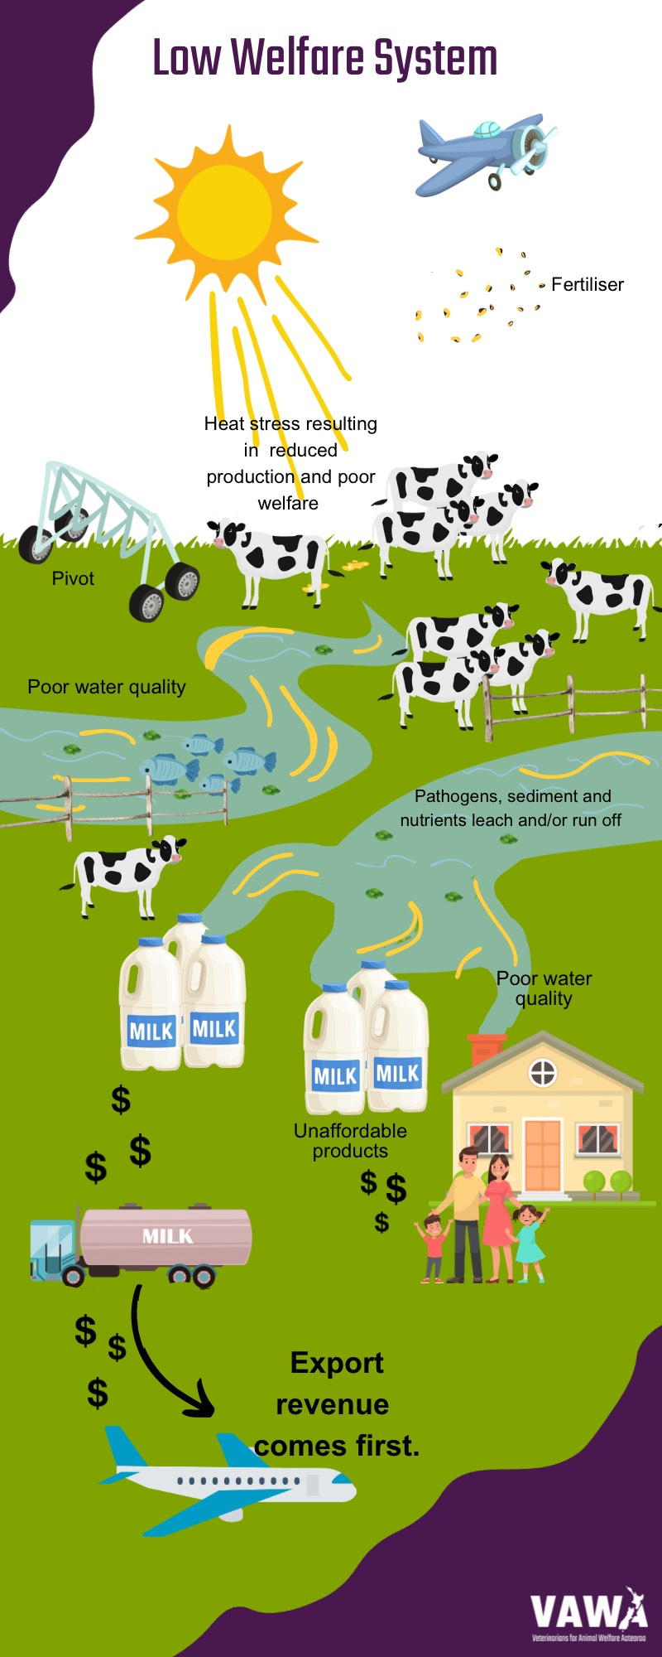
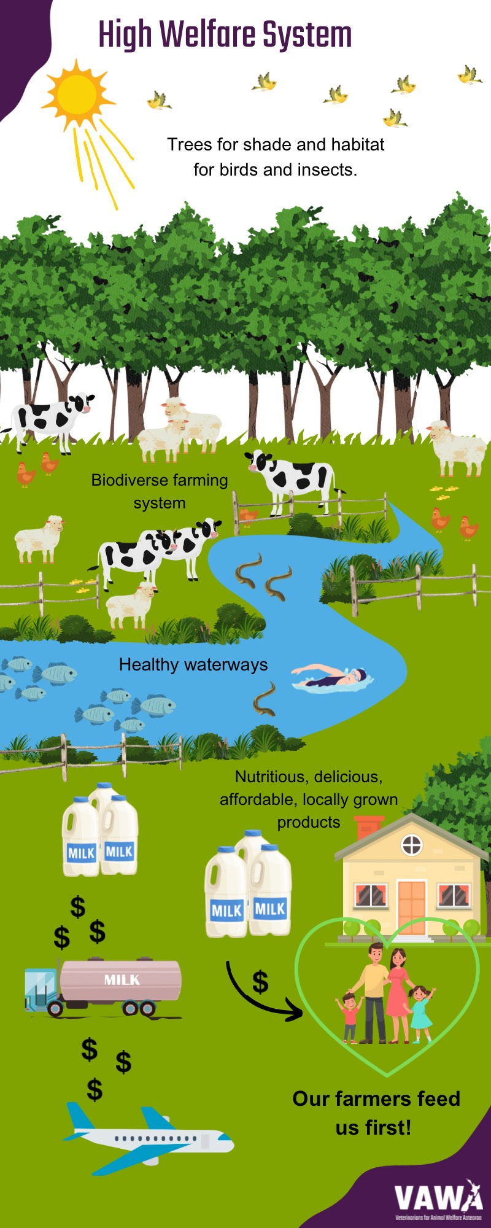
Biggest challenges
2. Seeking the wrong goal | perpetual, extractive growth
Volume vs value
consents - banks – mortgages – profit (aka volume; based on current farm advisory services) – Fonterra et al - export revenue – GDP – Government’s (global) measure of success
monocultures requiring inputs (N, P, PKE, water, tillage)
Climate change, GHG, biodiversity – knowledge vs wisdom
Lack of systems thinking animals suffering because they are always left out!
All are a symptom of ecological overshoot; fix the cause.
Supported by misinformation
‘Feeding the world’ = ‘reach’ 40-50 million – ‘If we fell off the Earth, no one would notice’ - AM
WMP confectionary; wine; water
local food insecurity
Clean, green, pristine Aotearoa (including our water) – what about externalities?
…and welfare washing.
‘World leading animal welfare’/ ‘high welfare standards’ – LIVESTOCK EXPORTS!
Welfare vs wellbeing – weasel words to gloss over suffering
No robust AW assurance (NZ or global) nor metrics (eg banks)
Food production responsible for 80% of biodiversity loss
GPS coordinates for farms and palm kernel - JM
Light, local biodiverse food systems - DR
Notes:
Example of wickedness

Slide 15
Biggest challenges,
pace of change, amplification
3. Siloed policy
connected policy and a VISION
A VISION FOR AOTEAROA NEW ZEALAND
WELLBEING OF FUTURE GENERATIONS ACT (Aotearoa)
ONE HEALTH ONE WELFARE ADVISORY COMMITTEE
People:
Poor - weak - no -wrong leadership
Animal:
Planet:
Economics over environment
Lack of understanding about animal welfare
Deprioritisation of animal welfare
Focus on GHG, not ecological overshoot
Goodies keep heads down, don’t get heard, or get sacrificed
Profit over welfare
Extractive economy
Dr. B Helen Beattie, Managing Director
Veterinarians for Animal Welfare Aotearoa
M | 021 1226796 E | info@vawa.co.nz W | vawa.co.nz
Notes:
2. What would improve the pace of change?
3. How do we amplify the pace of change, and bring others on the journey?

Slide 16
Principles Pace of change
Create a safe narrative
Based on science
Using HBC principles
enable people to understand the urgent need for an eternal vision for Ao/NZ implemented via an holistic policy approach … aka
Wellbeing of Future Generations Act (Aoteaora) 2030
Interconnectedness of welfare
One Health | One welfare
Te ao Māori frameworks
Wicked problems
Simple outcome
Complicated pathway
Solution vs response
Human behaviour change science (HBC)
Logic bullying vs HBC narrative
Dr. B Helen Beattie, Managing Director
Veterinarians for Animal Welfare Aotearoa
M | 021 1226796 E | info@vawa.co.nz W | vawa.co.nz
Notes:
2. What would improve the pace of change?
3. How do we amplify the pace of change, and bring others on the journey?

Slide 17
Summary
By understanding that the welfare of Papatūānuku is paramount, and connected to the welfare of people and animals, we can create resilient future farming systems with better welfare for all.
We need a united (BHA) vision.
We need different leadership to achieve this.
Wickedness and welfare are interconnected and need multiple responses; there’s no single solution.
Our responses must keep Papatūānuku (and therefore, us) safe for the very long term.
The second last word:
‘Our first priority is to care for the land; there are no exceptions, not even fixing the economy.’ - PR
Dr. B Helen Beattie, Managing Director
Veterinarians for Animal Welfare Aotearoa
M | 021 1226796 E | info@vawa.co.nz W | vawa.co.nz

Slide 18
The last word – animals’ lives matter.* #protecttheban on livestock exports. Please sign John’s petition.
*Paraphrasing Po Ropata (2024)
Dr. B Helen Beattie, Managing Director
Veterinarians for Animal Welfare Aotearoa
M | 021 1226796 E | info@vawa.co.nz W | vawa.co.nz

